Slide 1
Software Engineering :
Syllabus
Professor Imed Bouchrika National School of Artificial Intelligence imed.bouchrika@ensia.edu.dz

Slide 2
Outline :
Aims and Objectives
Course Content
Why it is important
Teaching Staff
Evaluation & Assignments
Resources
Ethics & Policies.

Slide 3
Aims & Objectives
The aim of this module is to provide the basic concepts for creating a functional and usable software product via complying with the principles of Software Engineering.

Slide 4
Aims & Objectives
The objectives :
Describe and compare various software development methods and understand the context in which each approach might be applicable.
Develop students’ critical skills to distinguish sound development practices from ad-hoc practices, judge which technique would be most appropriate for solving large-scale software problems, and articulate the benefits of applying sound practices.
Expand students’ familiarity with mainstream languages used to model and analyze object designs.

Slide 5
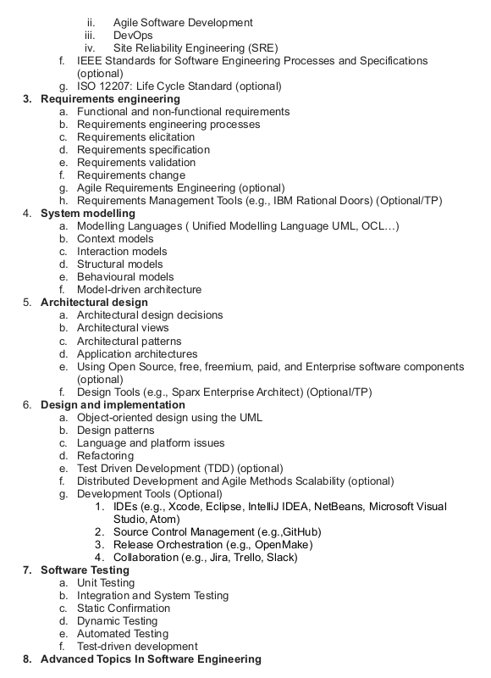
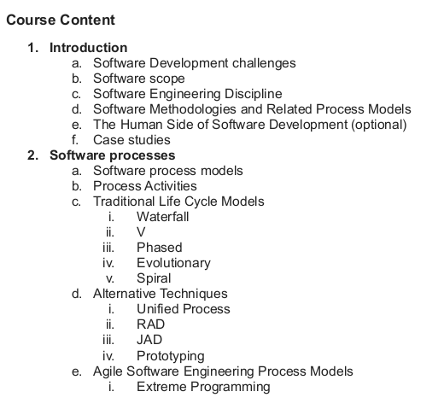
Course Content

Slide 6
Why it is important ?
In this course , you will :
Be taught the process for developing and delivering a professional software project.
Be given the opportunity to work within a simulated professional environment by working inside a team to deliver a software product.
Acquire most of the technical skills, technological tools and competences that you can publish on your CV.
Combine all notions and theories learnt in other courses ( Programming, Management, Problem Solving, Data Structures…) into solving a concrete problem

Slide 7
Teaching Staff
Professor Imed Bouchrika imed.bouchrika@ensia.edu.dz
TD:
Dr. Karim Lounis (Office hours: Thursdays, 1:30 to 3:00, C0-02) karim.lounis@ensia.edu.dz
Dr. Iness Nedji iness.nedji@ensia.edu.dz
TP:
Dr. Seifeddine Bouziane seifeddine.bouziane@ensia.edu.dz
Dr. Khadidja Chettah khadidja.chettah@ensia.edu.dz

Slide 8
Evaluation & Assignments
Exam : 40%
Continuous Evaluation : 60%
Online Quiz : 6 points :
Team Project : 14 points
Challenge Exercises : 3 points (Extra credit)
NO MIDTERM EXAM
Late Submission :
1 day Penalty of 20%
2 days Penalty of 50%
3 days → Zero mark is given.

Slide 9
Quizzes (6 points)
Quiz will be available either :
After the lecture and closed on the same day
During the lecture only.
Missing three quizzes, zero mark will be given directly and all other submissions will not be considered.

Slide 11
Quizzes (6 points)
Online Quizzes should preferably be done before attending the tutorial sessions.
Quizzes include easy/medium M.C.Questions aimed to enforce your understanding for the concepts discussed during the lecture.
PLEASE : Don’t rush to answer the quiz, take your time, search for the solutions on the web and submit your answers when you are certain.
The quiz will be open only during the lecture day. ( To ensure students will not procrastinate doing their revision and homework)

Slide 12
Group Project (14 points)
Team Creation :
Teams of 5 or 6 members will be created.
You will not be choosing who will work with you. ( Exception made in this year)
The staff will create project team before the TD session by randomly selecting students in the same TD Group.
You are not allowed to change your team to another team.
The aim : You are employed with within a team, learn how to live, integrate and adapt to what differences, conflict you will be having.

Slide 13
Group Project (14 points)
Team Leader :
Up to the team to have a democratic process to select a leader or any other process they like to invent .
But we need to have a student name as a Team Leader from week 1
Deadline : Saturday 18 Feb 2023

Slide 14
Group Project (14 points)
Project Topic :
Two Options:
The team can come up with an idea for a project to implement.
Provided it is validated by a staff
Deadline : Thursday 23 February 2023
We will give you one topic (NOT OPTIONS OF TOPICS)
The project topics must :
Feasible within the resources you have
Will be used by real people .
It solves an existing problem
Not over ambitious.

Slide 15
Group Project (14 points)
Marking Per Student or Per Team :
We will give one Mark per Team.
You work all a a team, you either all win or all lose.
If other students are not contributing ? it is not fair that he/she gets the same mark as a working person ? :
Write an official letter detailing what’s going on to penalize the non-working students.
We will execute based on what you officially write and sign.

Slide 16
Group Project (14 points)
Marking Schema :
Continuous Evaluation (TD and TP ): 4 points
Weekly Reporting and Briefing
Reaching Milestones
Making Continuous Deliverables and respecting deadlines.
Final Delivery : 10 points

Slide 17
Group Project (14 points)
Marking Schema :
Continuous Evaluation : 4 points
Final Delivery : 10 points
Functional Software : 3 points ( Non functioning software ⇒ 0pts)
There are real* users of your software : 2 points
Design and Implementation : 1 points
Documentation : 1 points
Demonstration : 1 points
Reporting and Management : 1 points
Non-Functional Requirements : 1 points
*Real users means not fake, bots, or ENSIA students or relatives

Slide 18
Group Project (20 points)
Exceptional Project :
The team developing a professional software having an exceptional impact
Considerable* number of active real users.
Fully functional
Professional Branding and Packaging
Students of the selected team, will get the full mark for :
All the quizzes ( Provided they don’t miss three quizzes)
The group project
Only one team will be selected
*Real users means not fake, bots, or ENSIA students

Slide 19
Challenge Questions (3 points of extra credit)
Meant for you to learn how to solve difficult problems that you may face in the future and you can not find their solutions on the web freely.
Solutions for the challenge Exercises will be submitted via Google Classroom when the Assignments are created. (It will be created without prior notice with only a one day deadline or subjected to quota)
Solving the exercises is optional, but you are encouraged to do so.

Slide 20
Attending Lectures
There would be quizzes during lectures from time to time. They will be graded.
Can the lectures be substituted by Youtube videos given by Top Scientists from MIT and Stanford ?
Are lectures about telling you what’s inside the book that you can read on your own ?
Deliberate missing of lectures would contribute to create a lazy atmosphere among the students + Accumulation of pressure and stress before the exam.

Slide 21
Tutorial Sessions - TD
Exercises of Prefix :
C : to be solved in class where you will be given some time to try to solve them.
A : Assignments/homework that you need to solve within a week deadline. You need to submit your solution via Google Classroom
P : Are optional exercises to be done at home after class. Discuss with your colleagues about the possible solutions. Feel free to bring your solutions to the lecturer to discuss in class when convenient.
Note that all P exercises are potential exam questions that they will be included into the final exams.

Slide 22
LAB Sessions - TP
TP Sessions will serve as :
An opportunity for students to work and collaborate on their projects.
Meeting sessions where teams brief their lecturer about their progress.
Lecturers can demonstrate new technologies or platforms to students
Important Note :
You won’t get assistance from us to :
Fixing bugs
Write some code for you.
Install some software or libraries for you.

Slide 23
Absence & Coming late
TP and TP :
Students being absent more than allowed, law will be strictly applied and students will be excluded.
Lectures
Students being absent more than 3 times in lectures, their marks for the online quiz will be set to Zero.
Being late :
Students coming 10 minutes late, will be allowed in class but they will be considered administratively absent.

Slide 24
Resources
Course Textbook : Ian Sommerville. “Software Engineering, Pearson Edition”, 2015.
Materials from other universities:
University of California, San Diago .https://cseweb.ucsd.edu/classes/su08/cse70/schedule.php
University of Toronto : http://www.cs.toronto.edu/~matt/csc444/lectures.html
California State University : https://www.cs.csub.edu/~gordon/3350/
Carnegie Mellon University : https://www.cs.cmu.edu/~aldrich/courses/413/

Slide 25
Policies
The use of Mobile Phones inside the classroom is prohibited. Disciplinary measures would be taken as it is considered as a disrespect to the lecturers whilst they are teaching.
Teams should not help each other for the principles they are competitors.
Teams can outsource no more than 30% of their project to external programmers or companies provided you pay them and you document everything being done externally + you sign a contract with them.

